Slide 1
Lab 3
Linearization of Time Delay
Root Locus

Slide 2
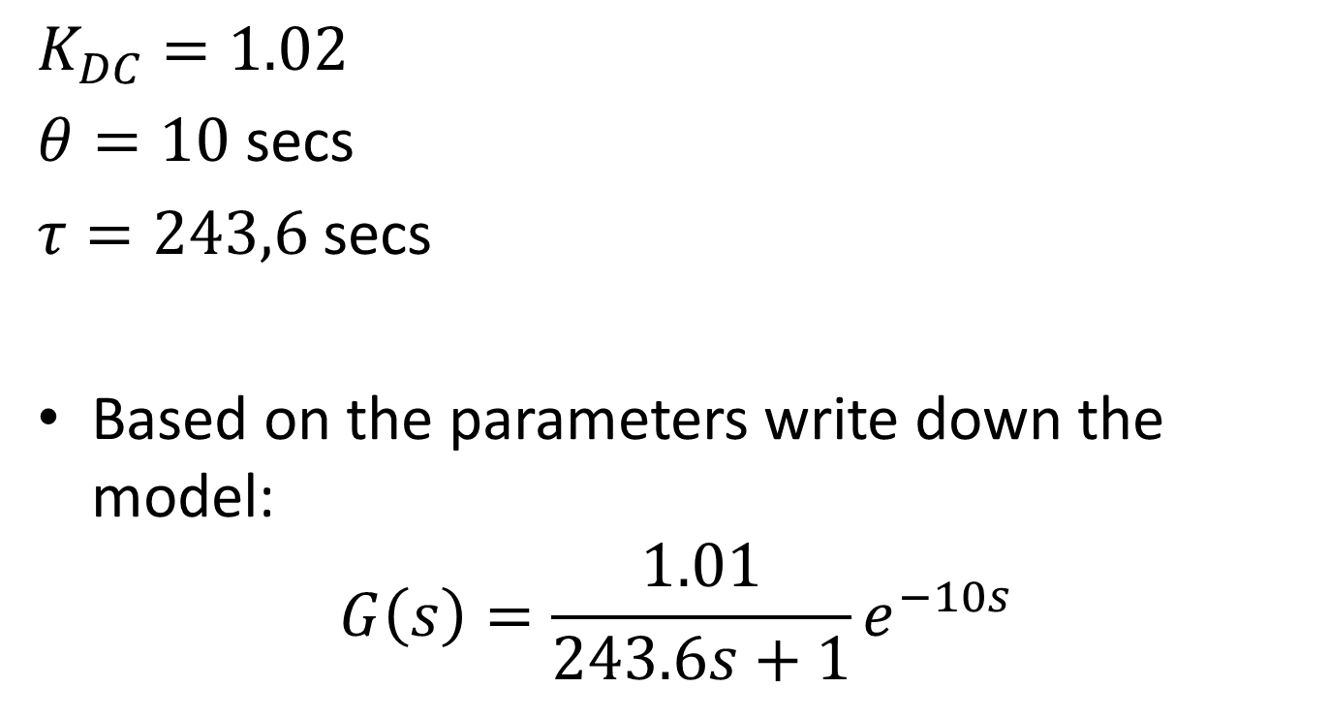
Prelab
$$K_{DC}=1.02$$
$θ=10$ secs
$τ=243,6$ secs
Based on the parameters write down the model:
$$G\left(s\right)=\frac{1.01}{243.6s+1}e^{−10s}$$

Slide 3
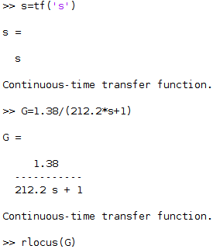
Activity 1
Let’s first exclude the time delay in our model, and draw the root locus:

Slide 4
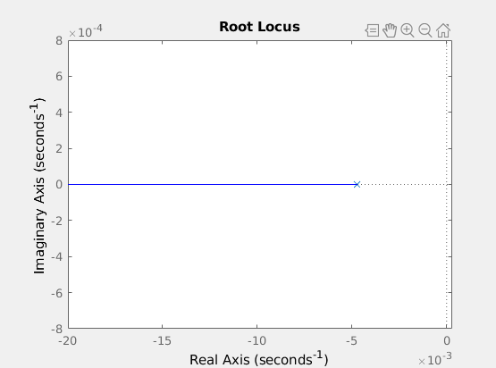
Activity 1
Can the closed loop system go unstable? Why?

Slide 5
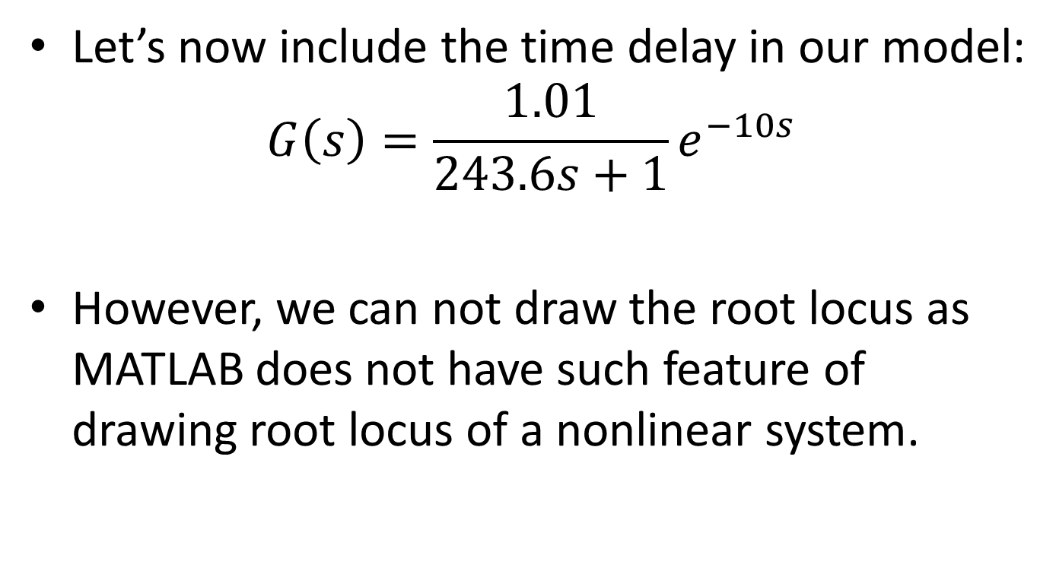
Activity 2
Let’s now include the time delay in our model:
$$G\left(s\right)=\frac{1.01}{243.6s+1}e^{−10s}$$
However, we can not draw the root locus as MATLAB does not have such feature of drawing root locus of a nonlinear system.

Slide 6
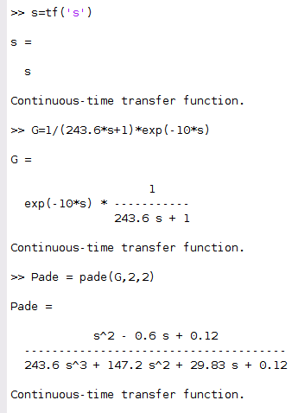
Activity 2
We will do a Padé approximation to generate a linear system that is quite close to our actual system.

Slide 7
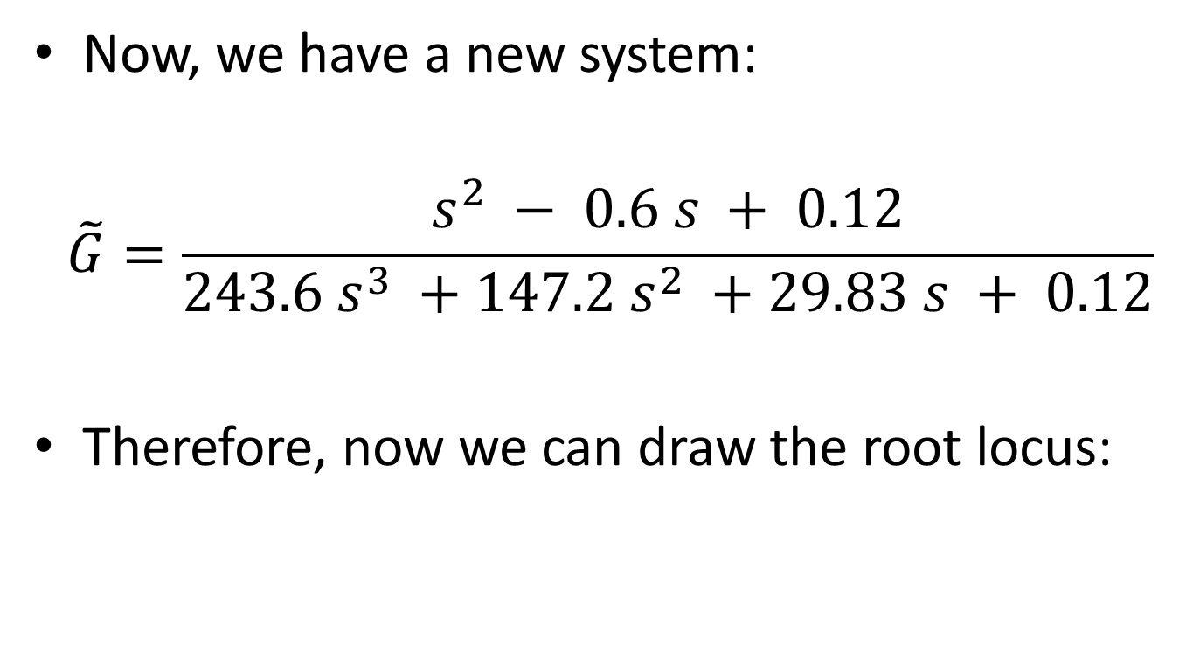
Activity 2
Now, we have a new system:
$$\tilde{G}=\frac{s^{2} − 0.6 s + 0.12}{243.6 s^{3} +147.2 s^{2} +29.83 s + 0.12}$$
Therefore, now we can draw the root locus:

Slide 8
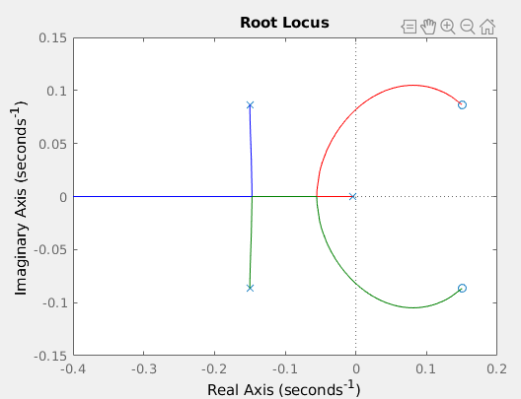
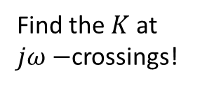

Activity 2
Can the system go unstable? Why?
$jω−$crossings
Find the $K$ at $jω−$crossings!

Slide 9
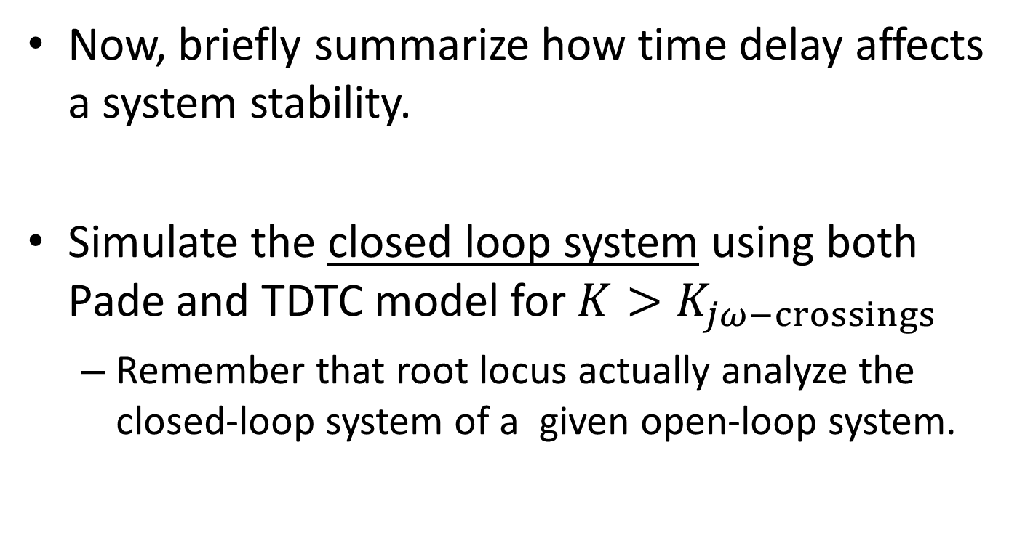
Activity 2
Now, briefly summarize how time delay affects a system stability.
Simulate the closed loop system using both Pade and TDTC model for $K>K_{jω−crossings}$
Remember that root locus actually analyze the closed-loop system of a given open-loop system.

Slide 10
Activity 2
Can you see how Pade actually linearize the nonlinear TDTC model?
Do you remember the Gibb’s phenomenon?

Slide 11
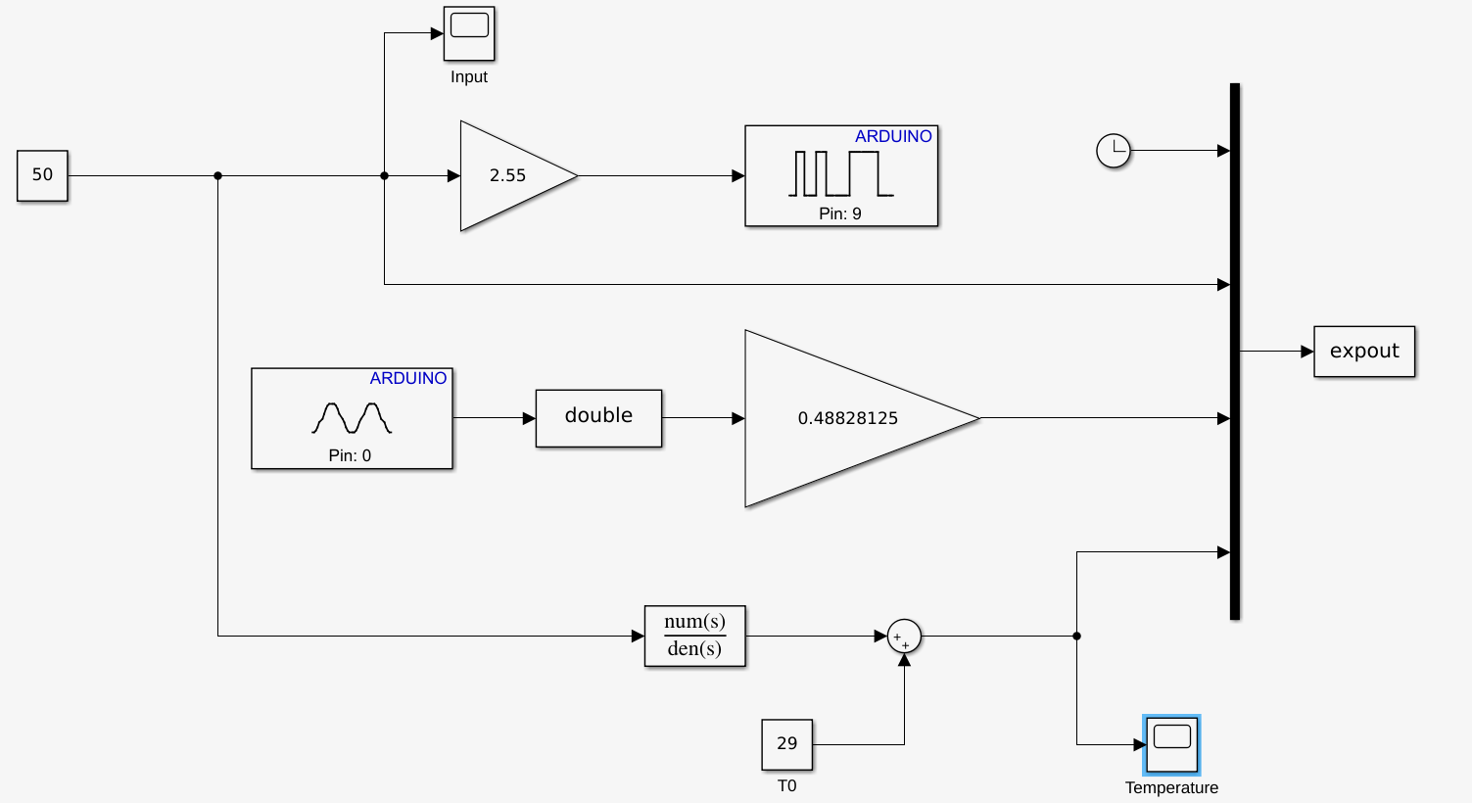

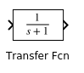
Activity 3
Let’s compare the model and the real system in real time:
Padé model
Use the transfer function block in Simulink,
Enter the coefficients for the numerator and denumerator:

Slide 12
Activity 3
Padé model

Slide 13
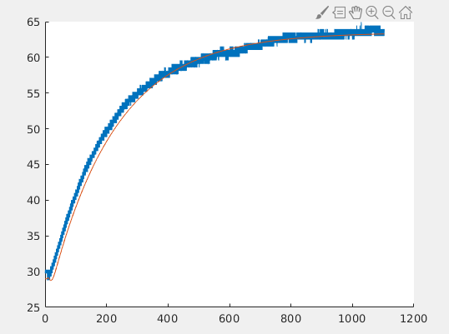
Activity 3
Find out the ambient temperature first.
You might need to reduce the sampling time to 10ms. Check if the overrun LED is on.

